Slide 1
Data structures and algorithms - Assignment
Tara Rhoseyn, Presentation

Slide 2


The business case
Library with 60+ records books that are to be sorted and organised. Users need to be able to add or delete books, as well as sort and search them.

Slide 3
The data
…
9780816638628,A Single Man,Christopher Isherwood,186,1964-01-01
9780141023380,Things Fall Apart,Chinua Achebe,197,1958-01-01
9780385336031,American Gods,Neil Gaiman,635,2001-06-19
9781400064113,The Great Gatsby,F. Scott Fitzgerald,180,1925-04-10
9780385490818,The Bell Jar,Sylvia Plath,244,1963-01-17
9780345342965,The Silmarillion,J.R.R. Tolkien,365,1977-09-15
9780553105937,The Stand,Stephen King,1153,1978-10-03
9780316769174,Slaughterhouse-Five,Kurt Vonnegut,275,1969-03-31
9780061120084,To Kill a Mockingbird,Harper Lee,384,1960-07-11
9780307267672,Blue Nights,Joan Didion,208,2011-10-01
9780141184272,Orlando,Virginia Woolf,336,1925-04-20
…

Slide 4
The data
ISBN
9781400064113,The Great Gatsby,F. Scott Fitzgerald,180,1925-04-10

Slide 5
The data
ISBN
Title
9781400064113,The Great Gatsby,F. Scott Fitzgerald,180,1925-04-10

Slide 6
The data
ISBN
Title
Author
9781400064113,The Great Gatsby,F. Scott Fitzgerald,180,1925-04-10

Slide 7
The data
Page
length
ISBN
Title
Author
9781400064113,The Great Gatsby,F. Scott Fitzgerald,180,1925-04-10

Slide 8
The data
Page
length
Date published
ISBN
Title
Author
9781400064113,The Great Gatsby,F. Scott Fitzgerald,180,1925-04-10

Slide 9
The data
Page
length
Date published
ISBN
Title
Author
9781400064113,The Great Gatsby,F. Scott Fitzgerald,180,1925-04-10
Used for searching
All used in sorting
Alongside order (ascending and descending)

Slide 10
The data
CSV file
List of Lists
CSV file

Slide 11


The data
List of Lists
Static size – making it less efficient for memory and storage
Less fast and efficient as other data structures for large datasets, e.g. dictionaries
Easy to index and access
Well suited for ordered and sequential data
Easy to work with
Mutable – making insertion and deletion easier
Notes:
Important note to bring up during slide: lists in python are not sized statically – I found it hard to get confirmation on this, but this week I have found out they are dynamically sized.

Slide 12
Overview of functions
Sorting | Searching | Insertion | Deletion | Utility | GUI
sort_books(attribute, order) sort_all_books() | search_for_book(search_term, attribute) | add_book(book_data, new_book) read_data_from_csv(filename) write_data_to_csv(data, attribute, order) | delete_book(isbn, book_data) | calc_length(book_data) view_books(data) get_attribute_name(attribute) get_filename(attribute, order) | launch_gui() exit() go_to_display() go_to_delete() go_to_add() go_to_search() go_to_main_menu() show_screen(frame) hide_screen(frame) back_from_display() back_from_delete() back_from_add() back_from_search() delete_btn_clicked() add_btn_clicked() sort_btn_clicked()

Slide 13
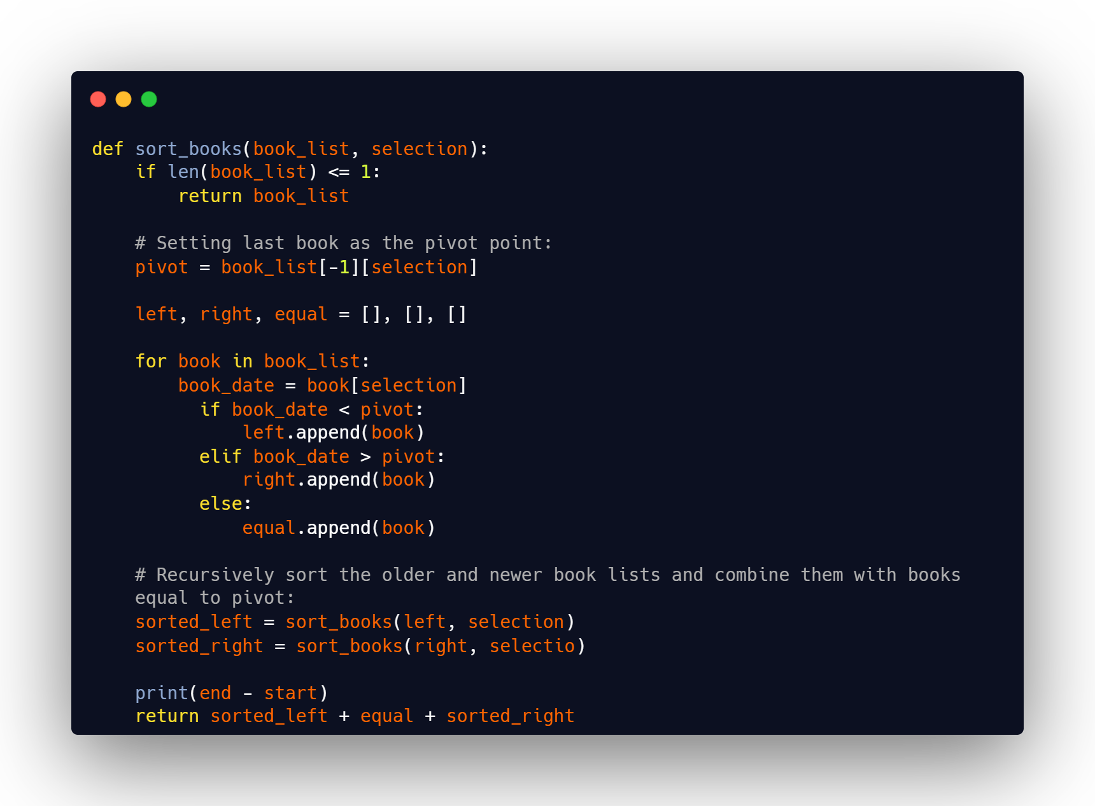

Slide 14
Sorting
First draft

Slide 15
Sorting
First draft
Adapted quicksort algorithm

Slide 16
Sorting
First draft
Adapted quicksort algorithm
Selects pivot (last element)
Partitions the data into three – left, equal, and right
Calls itself on the left and right partitions and sorts them
Combines partitions

Slide 17
Sorting
First draft
Adapted quicksort algorithm
Simple and very easy to read

Slide 18
Sorting
First draft
Adapted quicksort algorithm
Simple and very easy to read
It uses recursion – making it slow and inefficient

Slide 19
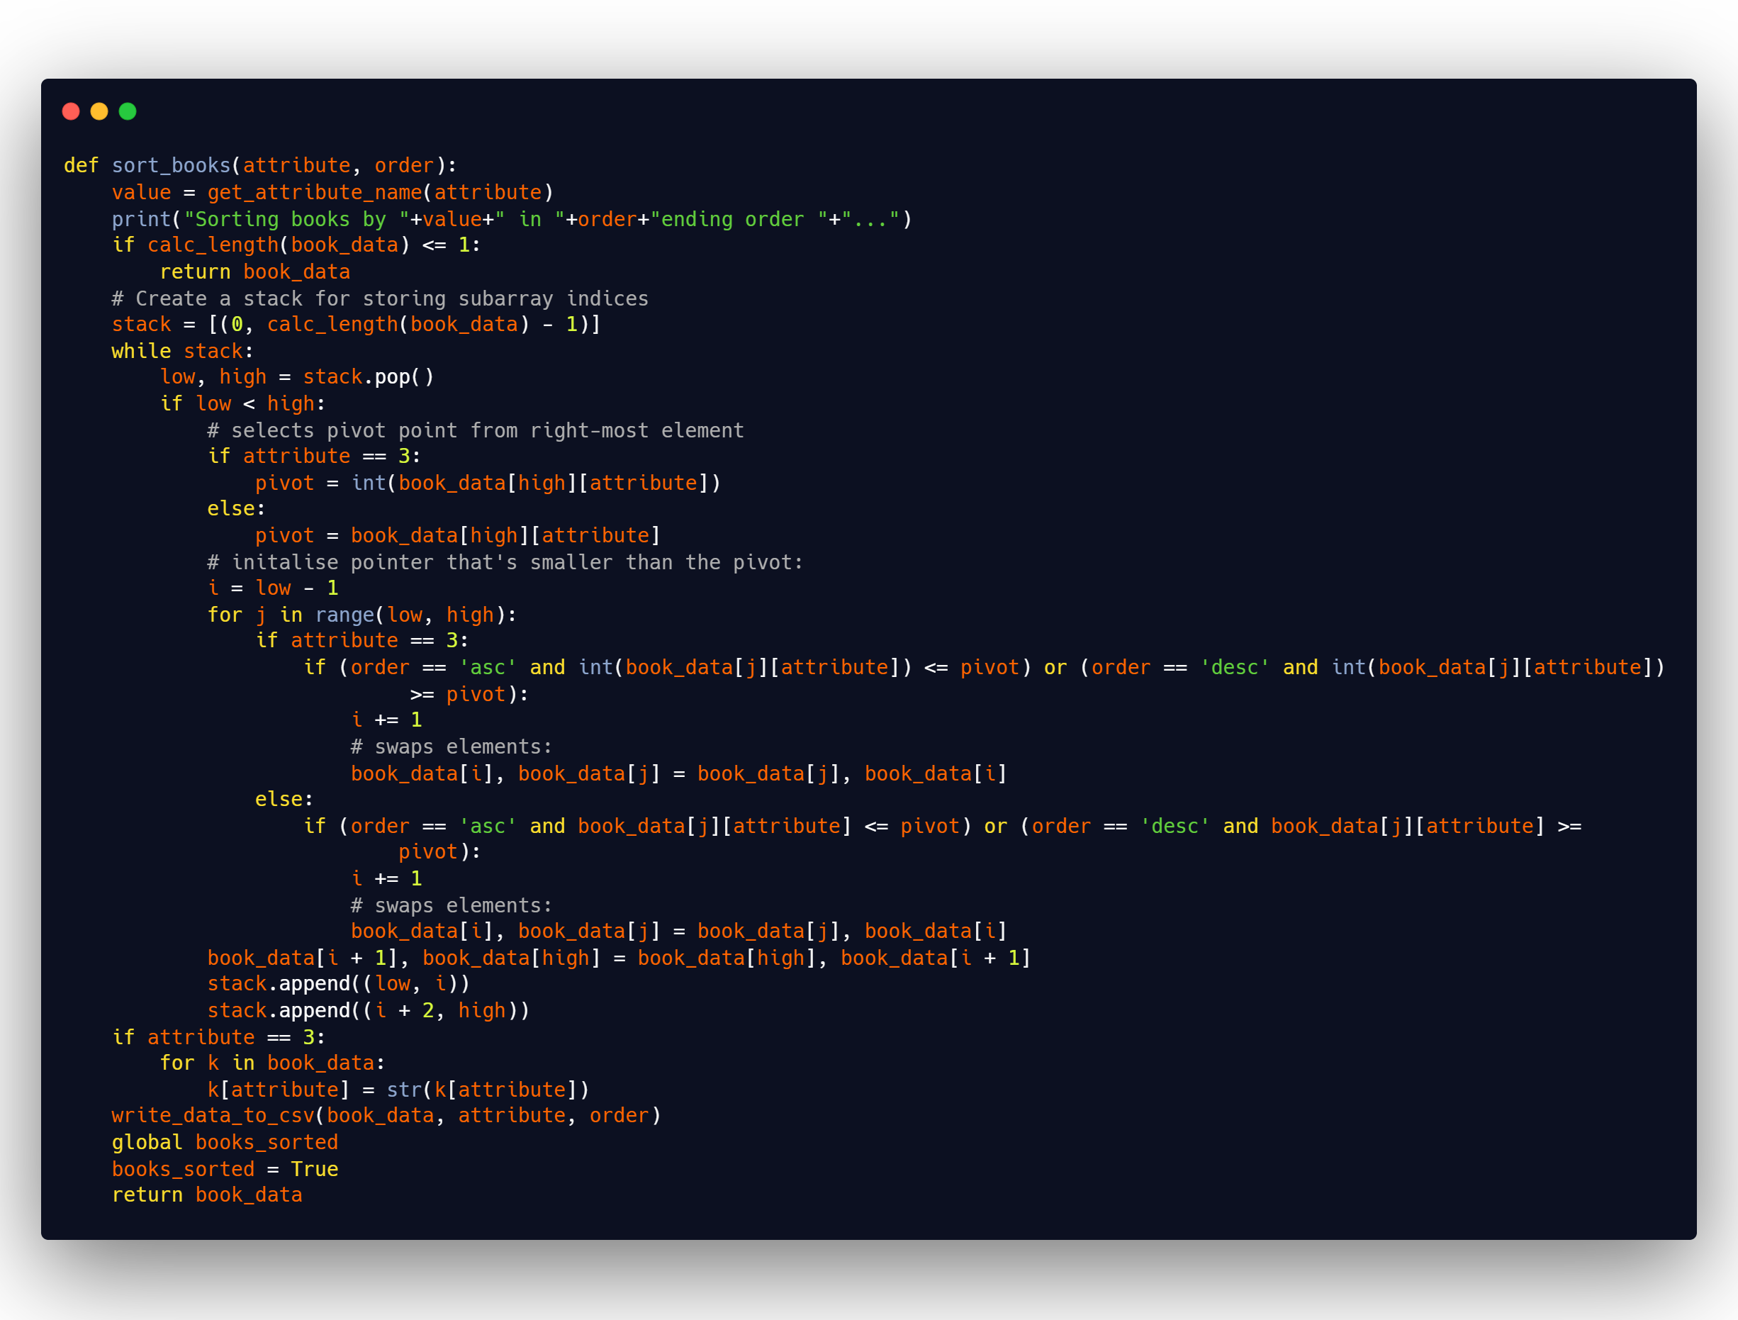
Sorting
Final draft
Iterative quicksort algorithm

Slide 20
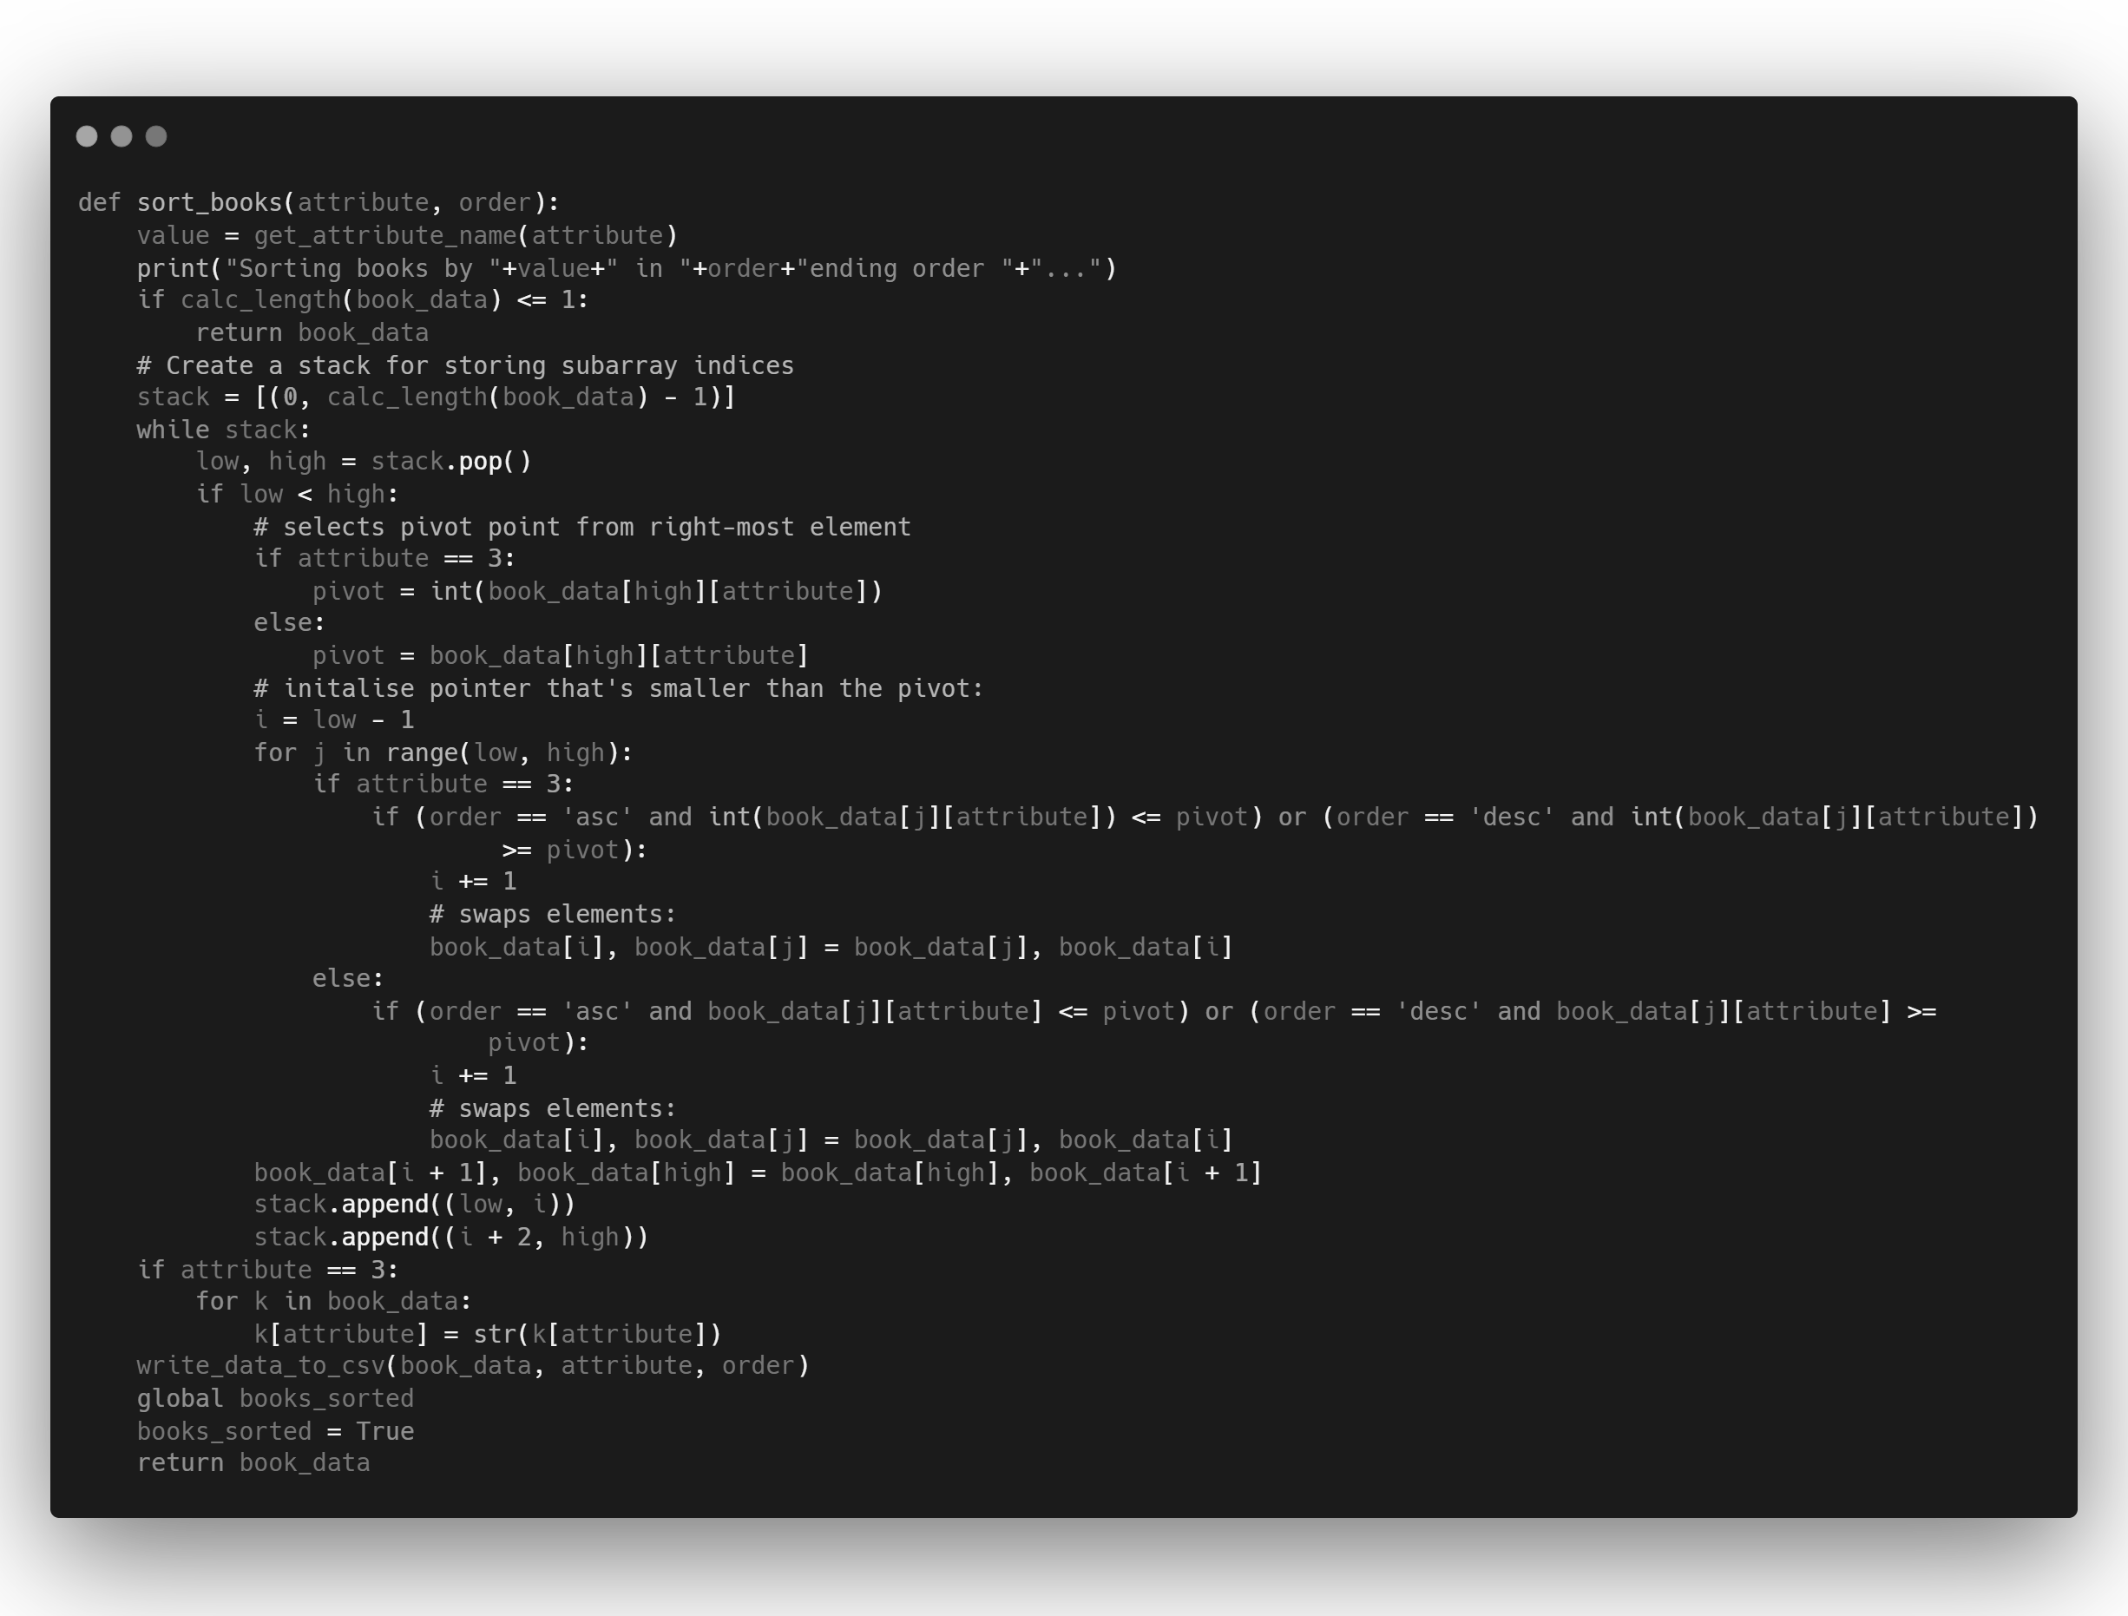
Checks whether list is already sorted

Slide 21
Creates stack, iterates through until empty

Slide 22
Selects pivot (right-most element)

Slide 23
Iterates through the subarray – compares elements, and swaps them as necessary
Notes:
def sort_books(attribute, order):
'''
Iterative quicksort algorithm to sort books by attribute (e.g., author/title/etc)
and order (asc/desc)
@attribute: int value representing inner list index where specific attribute is found (e.g., author/title/etc)
@order: str value of either asc/desc which will dictate what order the sort will go in
@return book_data: list of lists containing sorted data
'''
# Get the attribute name for printing purposes
value = get_attribute_name(attribute)
# Print a message indicating the sorting process
print("Sorting books by " + value + " in " + order + "ending order " + "...")
# Base case: if the length of the list is 1 or less, it's already sorted
if calc_length(book_data) <= 1:
return book_data
# Create a stack for storing subarray indices
stack = [(0, calc_length(book_data) - 1)]
# Iterate until the stack is empty
while stack:
# Pop subarray indices from the stack
low, high = stack.pop()
# Check if there are more than one element in the subarray
if low < high:
# Select the pivot point from the right-most element of the subarray
if attribute == 3:
pivot = int(book_data[high][attribute])
else:
pivot = book_data[high][attribute]
# Initialize a pointer that's smaller than the pivot
i = low - 1
# Iterate through the subarray
for j in range(low, high):
# Compare elements based on the specified order and attribute type
if attribute == 3:
if (order == 'asc' and int(book_data[j][attribute]) <= pivot) or (order == 'desc' and int(book_data[j][attribute]) >= pivot):
i += 1
# Swap elements
book_data[i], book_data[j] = book_data[j], book_data[i]
else:
if (order == 'asc' and book_data[j][attribute] <= pivot) or (order == 'desc' and book_data[j][attribute] >= pivot):
i += 1
# Swap elements
book_data[i], book_data[j] = book_data[j], book_data[i]
# Swap the pivot element to its correct position
book_data[i + 1], book_data[high] = book_data[high], book_data[i + 1]
# Push the indices of the subarrays to the stack for further processing
stack.append((low, i))
stack.append((i + 2, high))
# If the attribute is numeric, convert it back to a string
if attribute == 3:
for k in book_data:
k[attribute] = str(k[attribute])
# Write the sorted data to a CSV file
write_data_to_csv(book_data, attribute, order)
# Update a global variable to indicate that the books have been sorted
global books_sorted
books_sorted = True
# Return the sorted book data
return book_data

Slide 24
Returns pivot back to correct position
Notes:
def sort_books(attribute, order):
'''
Iterative quicksort algorithm to sort books by attribute (e.g., author/title/etc)
and order (asc/desc)
@attribute: int value representing inner list index where specific attribute is found (e.g., author/title/etc)
@order: str value of either asc/desc which will dictate what order the sort will go in
@return book_data: list of lists containing sorted data
'''
# Get the attribute name for printing purposes
value = get_attribute_name(attribute)
# Print a message indicating the sorting process
print("Sorting books by " + value + " in " + order + "ending order " + "...")
# Base case: if the length of the list is 1 or less, it's already sorted
if calc_length(book_data) <= 1:
return book_data
# Create a stack for storing subarray indices
stack = [(0, calc_length(book_data) - 1)]
# Iterate until the stack is empty
while stack:
# Pop subarray indices from the stack
low, high = stack.pop()
# Check if there are more than one element in the subarray
if low < high:
# Select the pivot point from the right-most element of the subarray
if attribute == 3:
pivot = int(book_data[high][attribute])
else:
pivot = book_data[high][attribute]
# Initialize a pointer that's smaller than the pivot
i = low - 1
# Iterate through the subarray
for j in range(low, high):
# Compare elements based on the specified order and attribute type
if attribute == 3:
if (order == 'asc' and int(book_data[j][attribute]) <= pivot) or (order == 'desc' and int(book_data[j][attribute]) >= pivot):
i += 1
# Swap elements
book_data[i], book_data[j] = book_data[j], book_data[i]
else:
if (order == 'asc' and book_data[j][attribute] <= pivot) or (order == 'desc' and book_data[j][attribute] >= pivot):
i += 1
# Swap elements
book_data[i], book_data[j] = book_data[j], book_data[i]
# Swap the pivot element to its correct position
book_data[i + 1], book_data[high] = book_data[high], book_data[i + 1]
# Push the indices of the subarrays to the stack for further processing
stack.append((low, i))
stack.append((i + 2, high))
# If the attribute is numeric, convert it back to a string
if attribute == 3:
for k in book_data:
k[attribute] = str(k[attribute])
# Write the sorted data to a CSV file
write_data_to_csv(book_data, attribute, order)
# Update a global variable to indicate that the books have been sorted
global books_sorted
books_sorted = True
# Return the sorted book data
return book_data

Slide 25
Pushes the indices of subarrays to stack to be processed
Notes:
def sort_books(attribute, order):
'''
Iterative quicksort algorithm to sort books by attribute (e.g., author/title/etc)
and order (asc/desc)
@attribute: int value representing inner list index where specific attribute is found (e.g., author/title/etc)
@order: str value of either asc/desc which will dictate what order the sort will go in
@return book_data: list of lists containing sorted data
'''
# Get the attribute name for printing purposes
value = get_attribute_name(attribute)
# Print a message indicating the sorting process
print("Sorting books by " + value + " in " + order + "ending order " + "...")
# Base case: if the length of the list is 1 or less, it's already sorted
if calc_length(book_data) <= 1:
return book_data
# Create a stack for storing subarray indices
stack = [(0, calc_length(book_data) - 1)]
# Iterate until the stack is empty
while stack:
# Pop subarray indices from the stack
low, high = stack.pop()
# Check if there are more than one element in the subarray
if low < high:
# Select the pivot point from the right-most element of the subarray
if attribute == 3:
pivot = int(book_data[high][attribute])
else:
pivot = book_data[high][attribute]
# Initialize a pointer that's smaller than the pivot
i = low - 1
# Iterate through the subarray
for j in range(low, high):
# Compare elements based on the specified order and attribute type
if attribute == 3:
if (order == 'asc' and int(book_data[j][attribute]) <= pivot) or (order == 'desc' and int(book_data[j][attribute]) >= pivot):
i += 1
# Swap elements
book_data[i], book_data[j] = book_data[j], book_data[i]
else:
if (order == 'asc' and book_data[j][attribute] <= pivot) or (order == 'desc' and book_data[j][attribute] >= pivot):
i += 1
# Swap elements
book_data[i], book_data[j] = book_data[j], book_data[i]
# Swap the pivot element to its correct position
book_data[i + 1], book_data[high] = book_data[high], book_data[i + 1]
# Push the indices of the subarrays to the stack for further processing
stack.append((low, i))
stack.append((i + 2, high))
# If the attribute is numeric, convert it back to a string
if attribute == 3:
for k in book_data:
k[attribute] = str(k[attribute])
# Write the sorted data to a CSV file
write_data_to_csv(book_data, attribute, order)
# Update a global variable to indicate that the books have been sorted
global books_sorted
books_sorted = True
# Return the sorted book data
return book_data

Slide 26
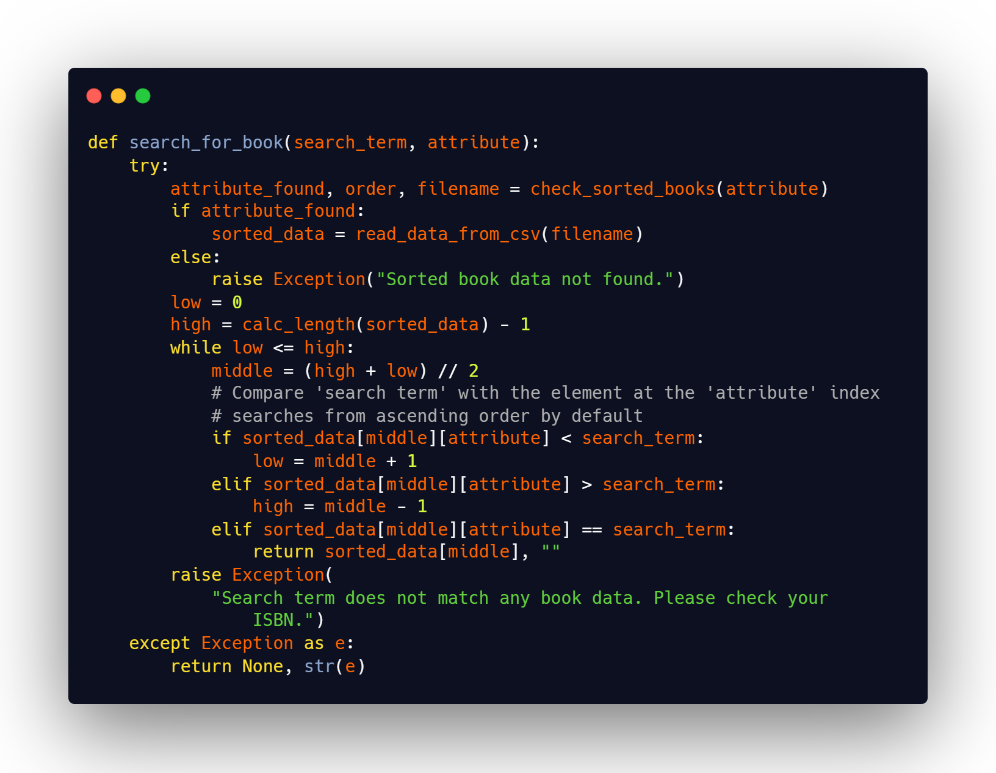
Searching
Binary algorithm

Slide 27
Searching
Binary algorithm
Highly efficient, time complexity of O(log n) compared to linear’s O(n)
Reduced number of comparisons through partitioning

Slide 28
Searching
Binary algorithm
Highly efficient, time complexity of O(log n) compared to linear’s O(n)
Reduced number of comparisons through partitioning
Requires data to be pre-sorted
More memory intensive

Slide 29
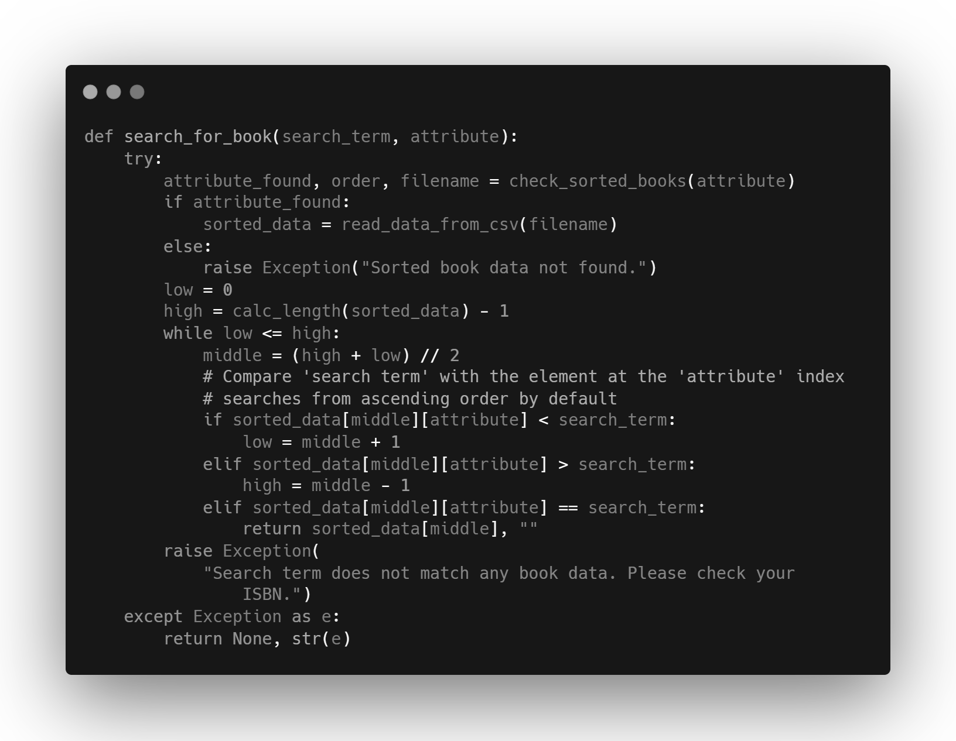
Checks whether books or sorted and populates list with sorted data according to attribute (using ascending order by default)

Slide 30
Sets initial values of low & high
Calculates middle index

Slide 31
If search term is greater then adjust low index, and vice versa
Notes:
Designed to work with any attribute, but in the GUI I’ve asked user to just use ISBN

Slide 32
If search term matches = result is found and returned
Notes:
Designed to work with any attribute, but in the GUI I’ve asked user to just use ISBN

Slide 33
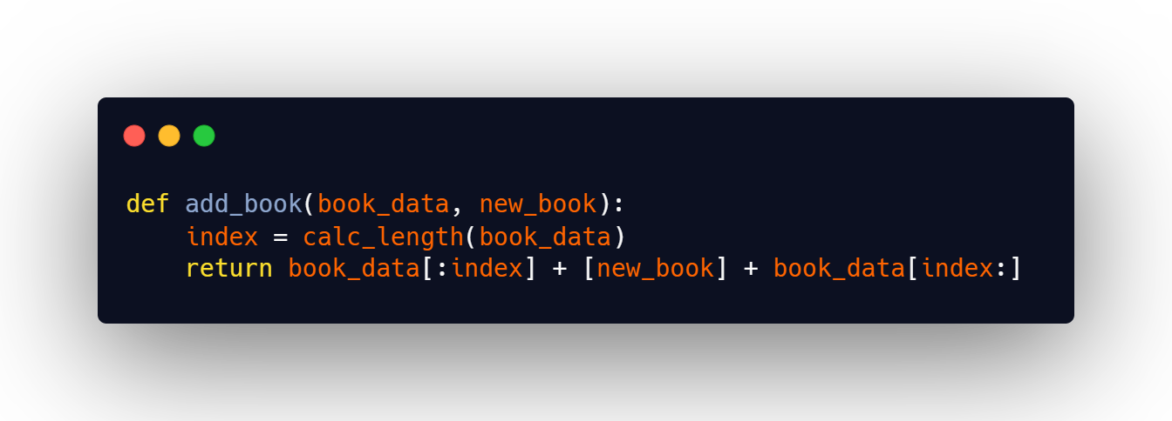
Insertion
Adding a book

Slide 34
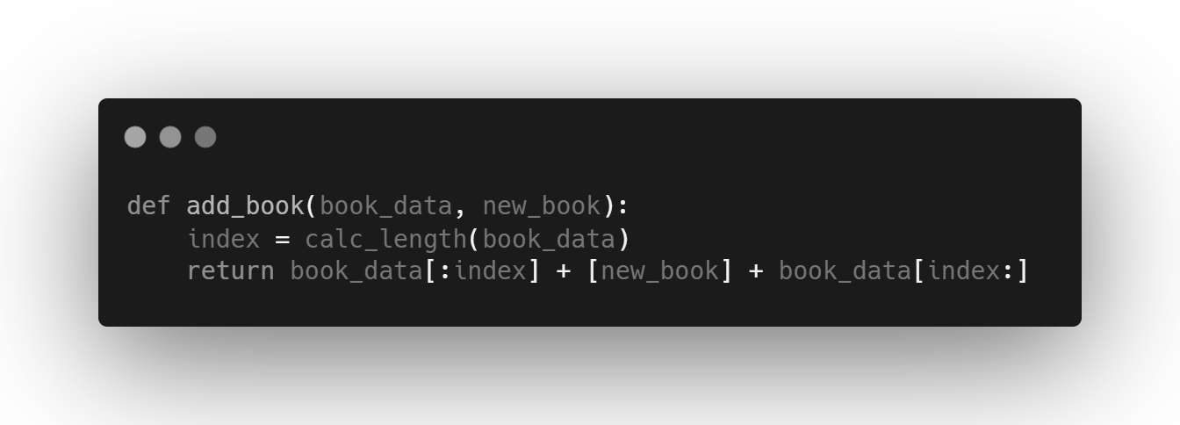
Sets index to last element

Slide 35
Uses Python’s slice notation to insert the new book before the last element

Slide 36
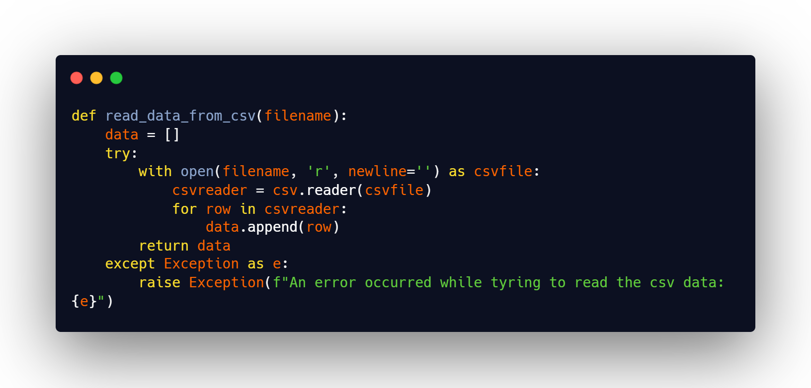
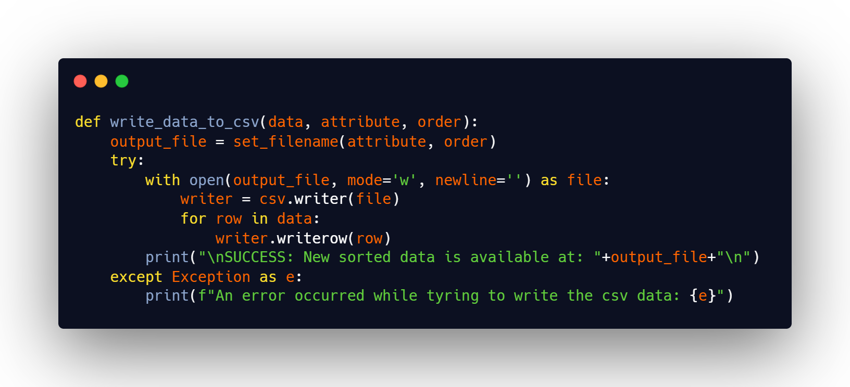
Insertion
From CSV to List

Slide 37
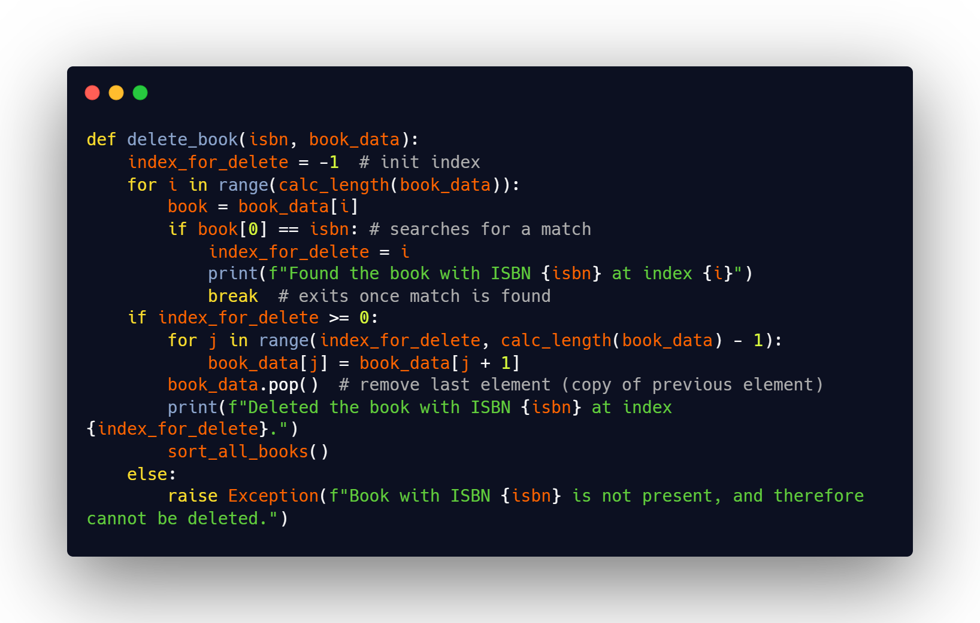
Deletion

Slide 38
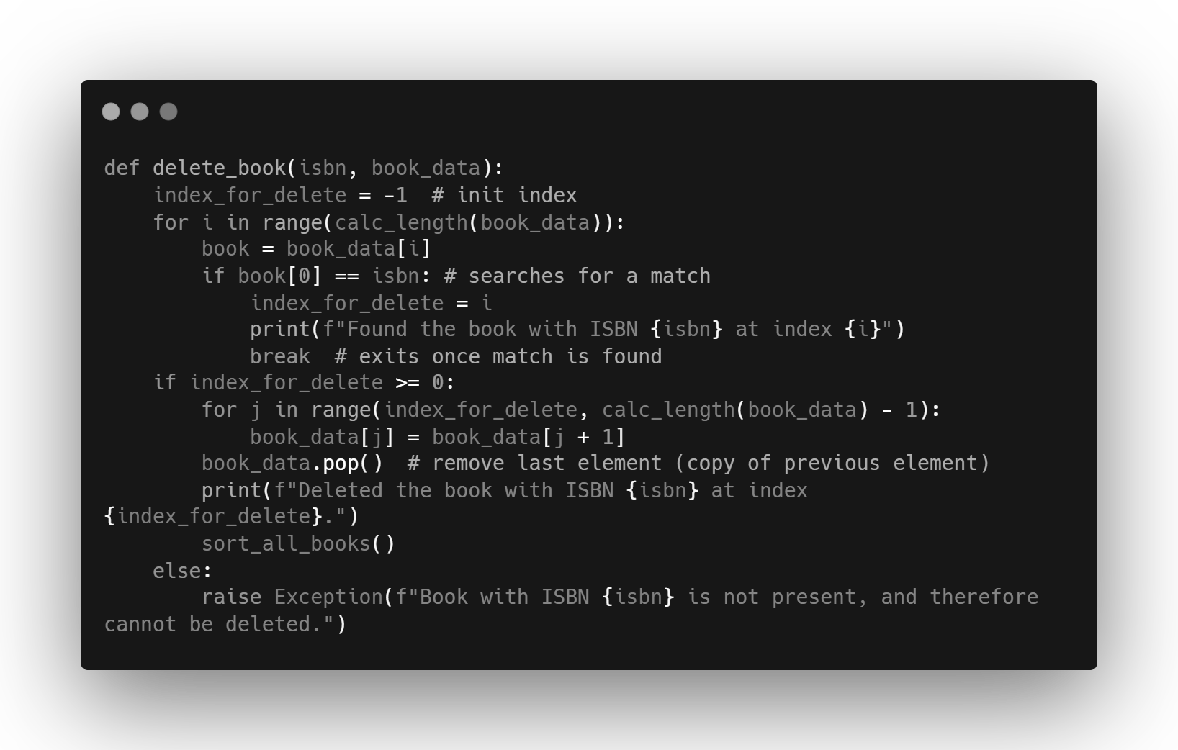
Initialises var to store index of book
that will be deleted, -1 for testing success case later

Slide 39
Linear search to find match with ISBN supplied
Notes:
Explain why this uses linear and not pre-existing binary search –
All sorted data is held across different CSV files rather than updating the list of lists, so it would only be helpful for updating the specific CSV file.
I also need to be resort the data after a book is deleted, which is why I have one list of lists which is the source of truth, and that re-exports out to the various CSV files with the sorted data

Slide 40
Indicates a match is found

Slide 41
Iterates through book_data from the point at which a match is found.
Replaces current index element with next index element

Slide 42
Removes last element (copy of second-to-last element after iteration)

Slide 43
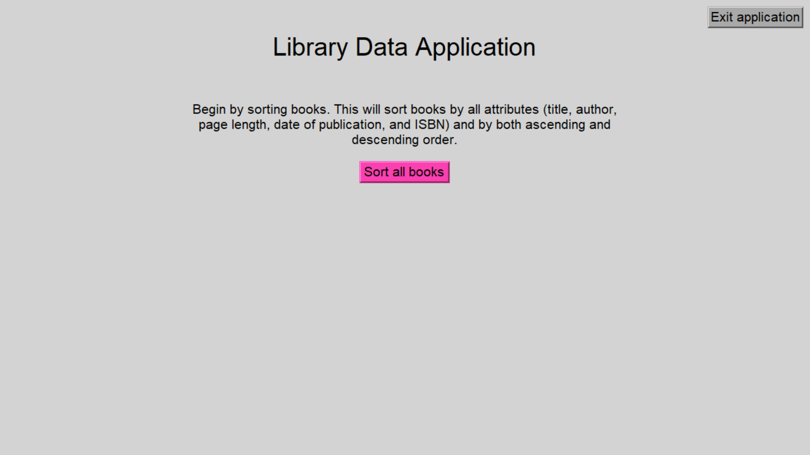
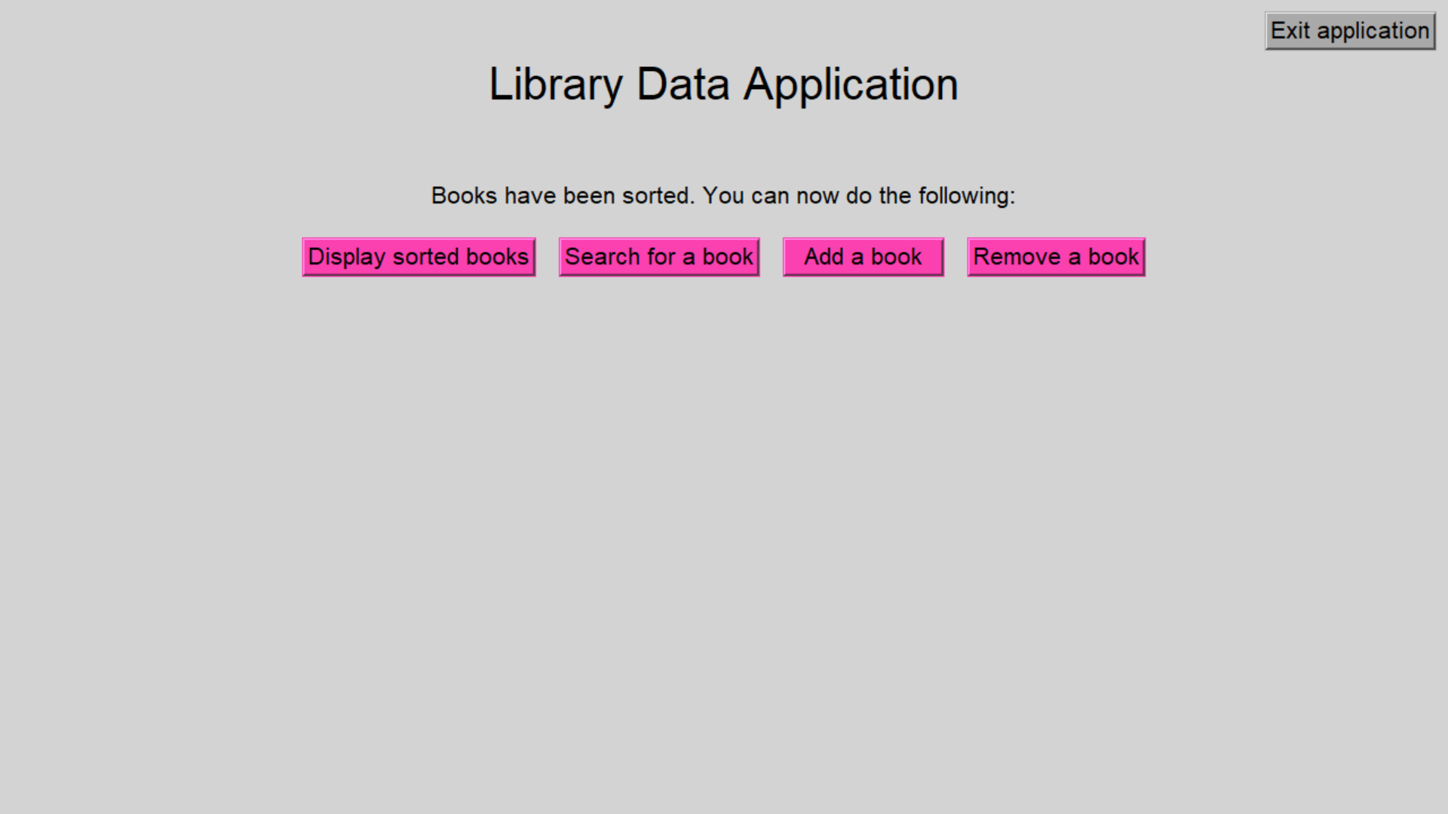
GUI
Using Tkinter

Slide 44
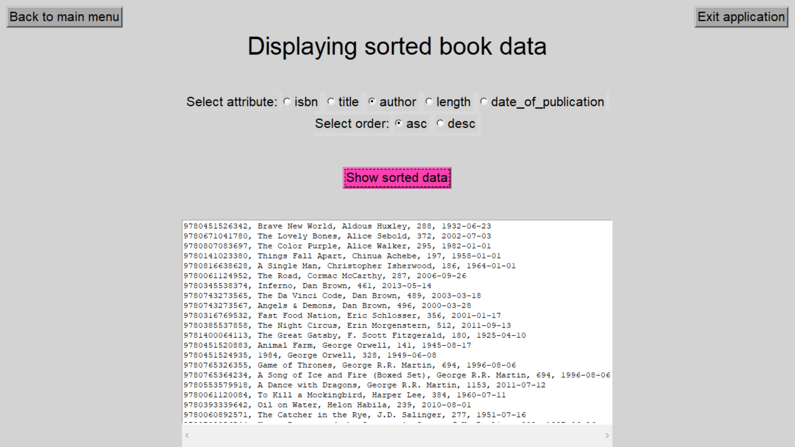
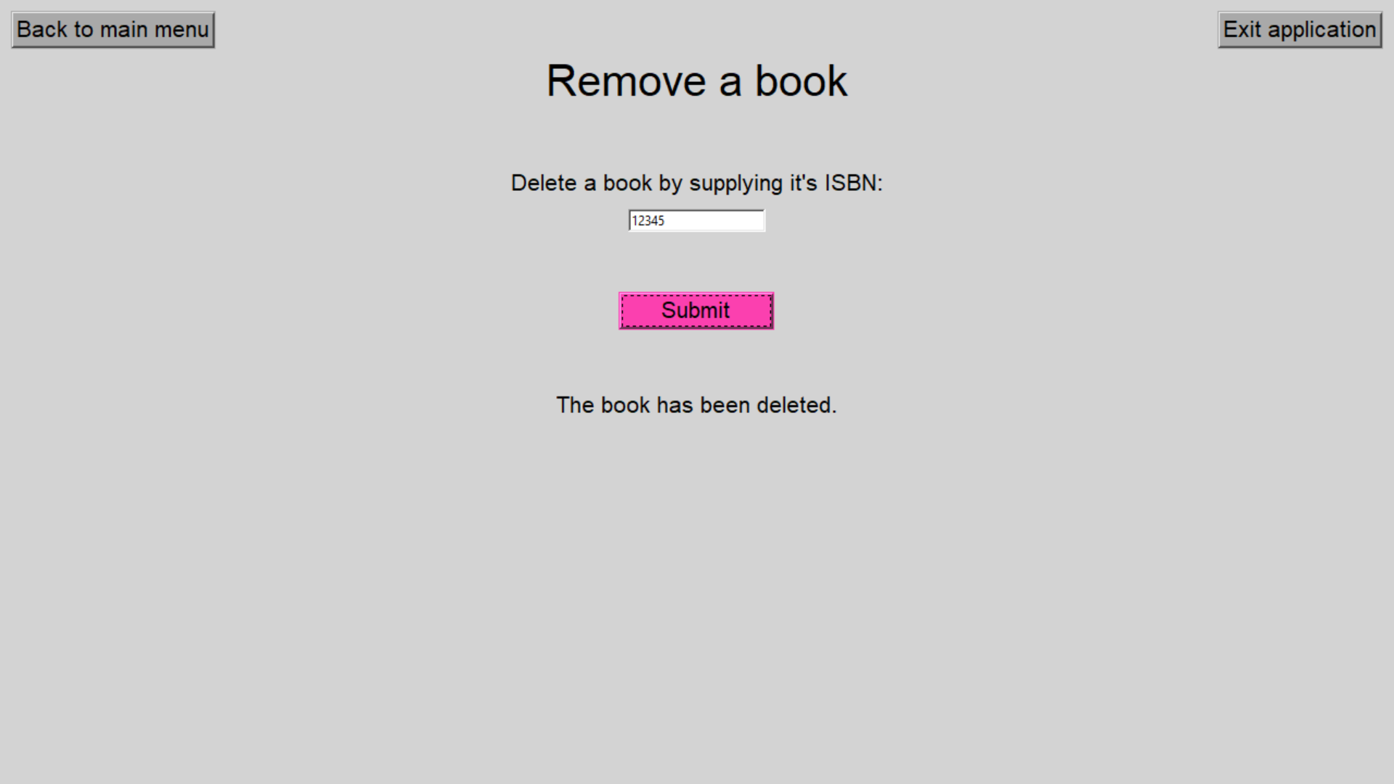
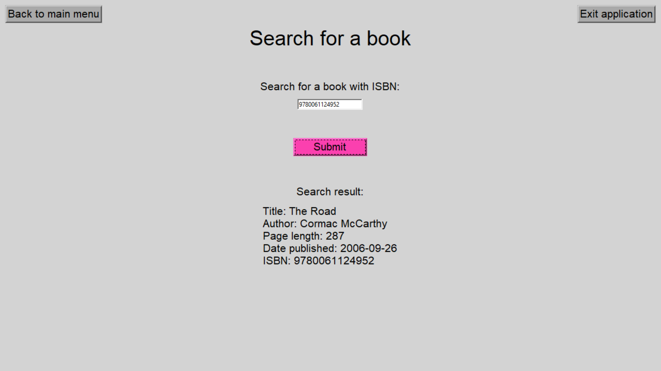
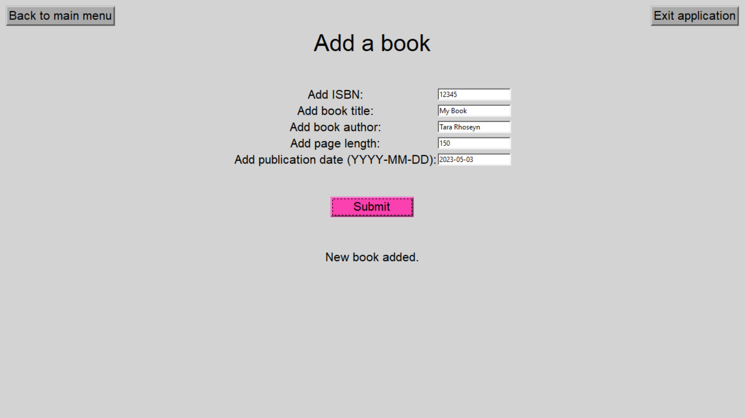
GUI
Using Tkinter

Slide 45
Thanks for listening!
Any questions?

